Slide 1

Gear4Camp - Outdoor Gear Rental - Iteration 1
Sneha Bangar,Henry Dinh,Varun Kasturi,Kainan Xu

Slide 2
Report Outline
Requirements
Use Cases
Diagrams and Models
Application Demo
Iteration 2

Slide 3
Requirements
Users can register for an account and become a member
Members can log into their accounts
Members may create ads
Users can browse ads on the home page

Slide 4
Use Cases
Use Case UC1: Sign Up
Use Case UC2: Login
Use Case UC3: Create Ad
Use Case UC4: Display Ads

Slide 5
Use Case UC1: Sign Up
Scope | Gear4Camp application
Level | User goal
Actors | User
Stakeholders and Interests | User: wants to register for an account in the Gear4Camp application to create ads
Preconditions | The User must have a valid email address
Success | User is registered and has an account
Extensions | Email is invalid and the system prompts the user to try again

Slide 6
Use Case UC2: Login
Scope | Gear4Camp application
Level | User goal
Actors | User
Stakeholders and Interests | User wants to be able to log into account to create ads
Preconditions | User has registered for an account (UC1).
Success | User is logged into account
Extensions | User enters invalid credentials and the system prompts the user to try again

Slide 7
Use Case UC3: Create Ad
Scope | Gear4Camp application
Level | User goal
Actors | User
Stakeholders and Interests | User wants to post an ad for equipment for renting
Preconditions | User has a valid account and is logged into the application (UC1 and UC2)
Success | Ad is created and is displayed on the homepage
Extensions | User hasn’t submitted all required information during ad creation and the system prompts the user to try again

Slide 8
Use Case UC4: Display Ads
Scope | Gear4Camp application
Level | User goal
Actors | User
Stakeholders and Interests | User wants to browse ads for renting equipment
Preconditions | User opens the Gear4Camp website
Success | User should be able to open the website and see all the ads posted
Extensions | N/A

Slide 9
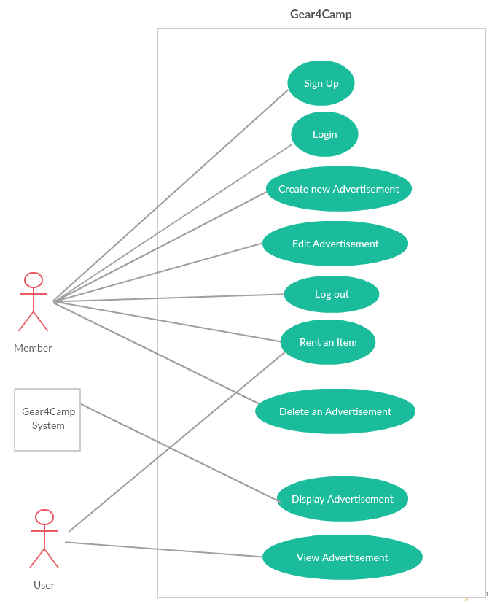
Consolidated Use Case Diagram

Slide 10
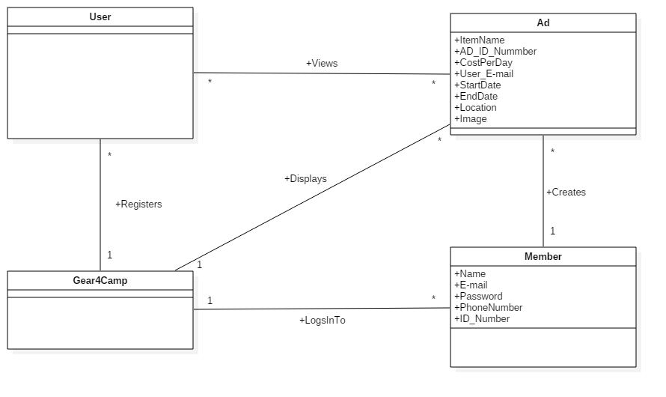
Domain Model

Slide 11
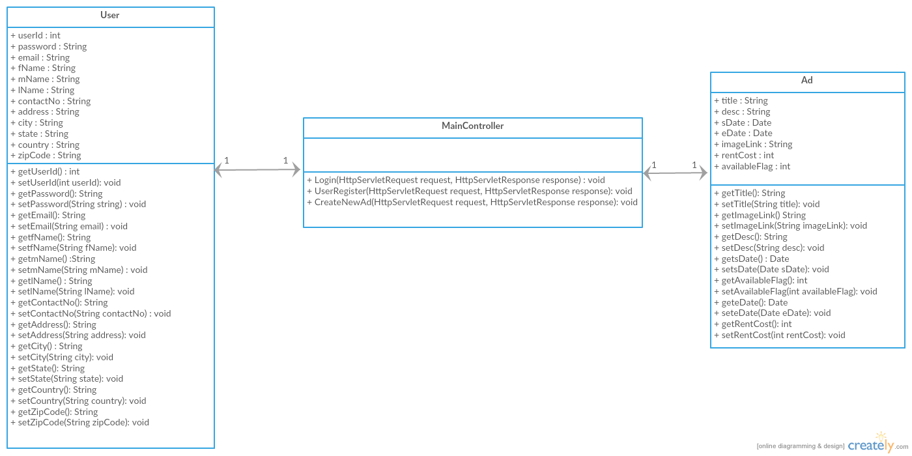
Class Diagram

Slide 12
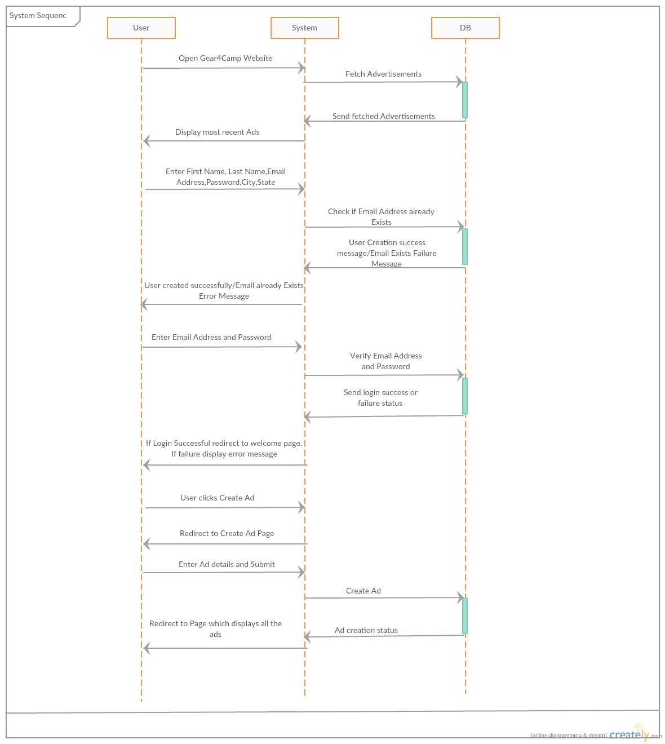
System Sequence Diagram

Slide 13
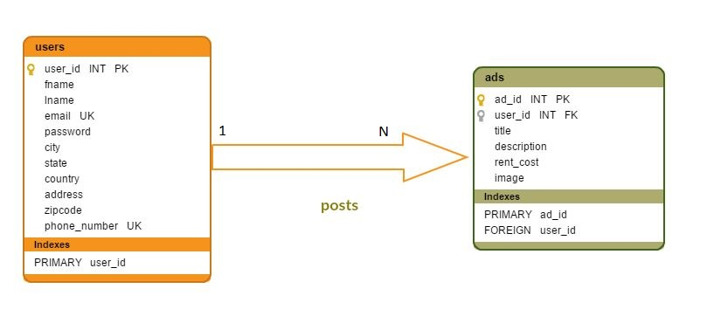
Database Schema

Slide 14
Application Demo

Slide 15
Iteration 2 Expectations
Member can view his account for history of ad postings
Logout
User can choose to rent product through the website
Search and filtering functionality for ads
Add categories to ads

Slide 16

Thank you !

